Slide 1
CS 5300 Project 2
Xi He, Yanjia Li, Long Ma

Slide 2
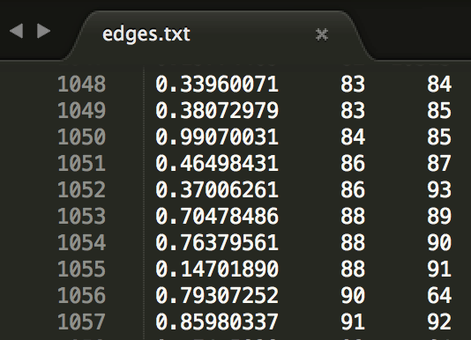
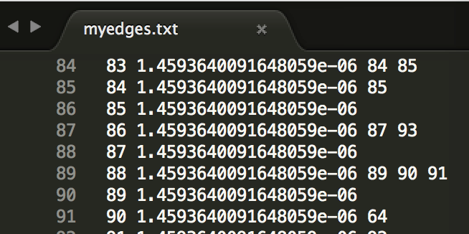
File Format

Slide 3
Simple Computation
Mapper reads the data line by line, data format for each line is:
NodeId PRvalue Outlink1, Outlink2, ...
For each line of data, Mapper sends splited PR value to each node in outlinks as well as each node info line.
Reducer collects PR value flowing from other nodes for one node and its own node info line
Reducer calculate new PR value for its own node and generate data input for next round

Slide 4
Mapper
Keyin: NodeId[,PRValue]
Valuein: [Outlink1, Oulink2, Outlink3, ...]
Keyout_1: dst_NodeId
Valueout_1: src_NodeId, PRValue, outlinks_amount
Keyout_2: src_NodeId
Valueout_2: src_PRValue, src_outlinks

Slide 5
Reducer
Keyin_1: NodeId
Valuein_1: src_NodeId, src_PRValue, src_outlinks_amount
Keyin_2: NodeId
Valuein_2: PRValue, Outlinks
Keyout: NodeId, PRValue
Valueout: Outlinks

Slide 6
Block Compute
Jobs: MapReduce passes. AvgResidual<0.001
Map(read line by line from file)
In: <LineNumofFile(longWritable), LineText(Text)>
out: <BlockID(longWritable), Data(Text)>
Reduce(write line by line to file)
in: <BlockID(longWritable), List<Data>(Text)>
out: <NodeID(longWritable), NodeInfoLine(Text)>

Slide 7
Mapper
Read text file line by line.
Each line/node contains {NodeID, PR, Outlinks}
ex: “123 0.234 45 86 90”
For each line/node
send entire line<flag, line> ex: “NodeInfo 123 0.234 45 86 90”
send to block of u
send BE: {flag, source node id, destination node id, source node degree} ex: “BE 32 43 3”
u→ v (send to block of v)
send BC {flag, destination node id, pageRank shared with it}. ex: “BC 34 0.02 ”
u→ v (send to block of v)

Slide 8
Reducer
Sort List<Data> for one block, put in HashMaps
degree_map<nodeID, degree>
pageRank_map && new_pageRank_map <nodeID, PR>
boundary_map <nodeID, List<PR_shared>>
edge_map <nodeID, List<inLinks> >
Others: forNextPass map<nodeID, NodeInfoText> && startMap (same as pageRank_map)
Run iterations
edge_map: add PR shared to each desti node to new_pageRank_map
boundary_map: add PR shared to each desti node from other blocks
new_pageRank_map: sum*0.85 +0.15/Num_OF_NODES
replace / update pageRank_map; calculate avgResidual<0.01?break;iter
3. Write To File
replace Node line Info with new PR in forNextPass map. Write to file on the fly
Sum the residuals of all nodes in block (start-end)/end. Put in counter

